Slide 1

Act Locally, Impact Globally

Slide 2
Lecture 2: Handling Missing Values

Slide 3
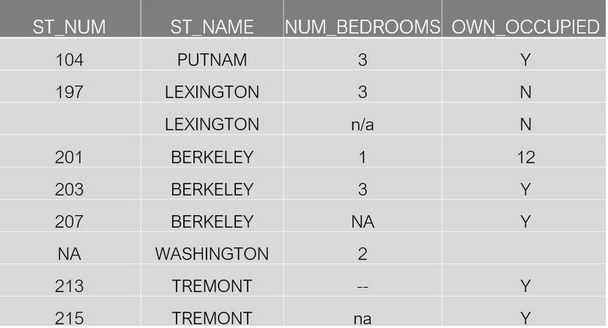
What are missing values ?

Slide 4
Why Missing Data Treatment is Required
Missing data in the training data set can reduce the power / fit of a model.
It can lead to a biased model because we have not analyzed the behavior and relationship with other variables correctly.
It can lead to wrong prediction or classification.
In some cases , we may not be able to apply a given algorithm if there are missing values in the data

Slide 5
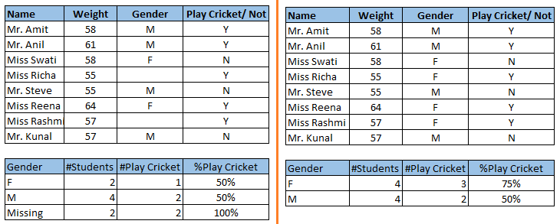
Why Missing Data Treatment is required

Slide 6
Why My Data Has Missing Values?
Data Extraction Problems
Data import from different data sources etc
Problems at Data Collection Level
The data is not available ( Non-Availability)
Data is not Mandatory for the business operations , so not recorded
Wrong data is also considered as missing data

Slide 7
Treating Missing Data
We can handle missing values by:
Drop Null or Missing Values Altogether
Fill Missing Values using Imputation ( Mean , Median , Mode)
Predicting Missing Values with Machine Learning Algorithm

Slide 8
Deleting Missing Values
This is the fastest and easiest step to handle missing values.
This method reduces the quality of our model as it reduces sample size.
If the missing data is less than 5 % for a large dataset , we can delete missing values :
Deleting 500 records from 10,000 records

Slide 9
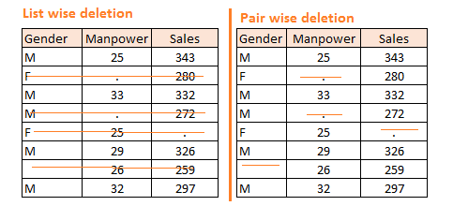
Deleting Missing Values

Slide 10
Missing Values Imputation
We can impute the missing values
Using mean and median for numerical attributes
Mean is sensitive to outliers
Using mode for Categorical Attributes
Using a Machine Learning Algorithm like KNN
It will give the maximum close estimation , but
It can be compute intensive

Slide 11
Handling Missing Values in Python

Slide 12
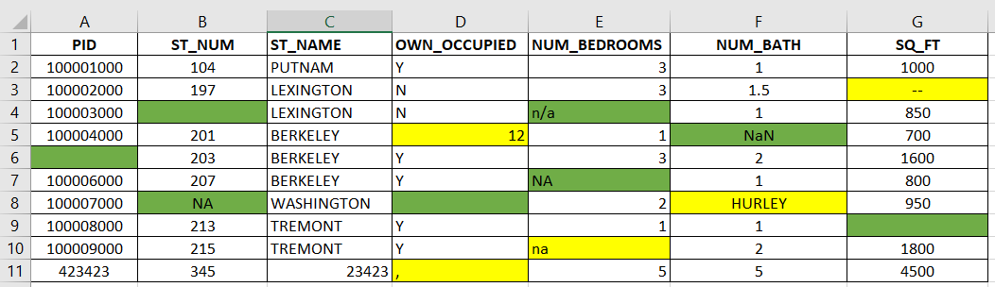
An Example Use Case

Slide 13
Missing Values Recognized by Pandas
A Pandas dataframe can recognize the following values as missing:
NA
NaN
n/a
N/A
Blank Field

Slide 14
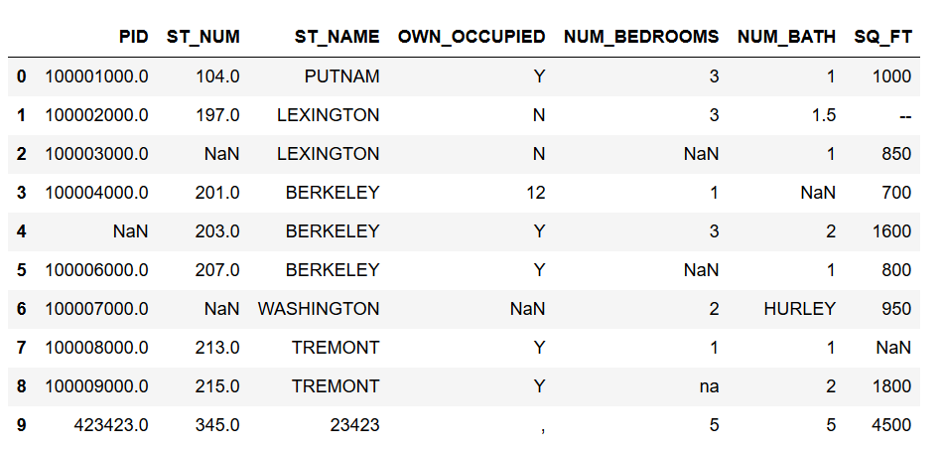

Slide 15
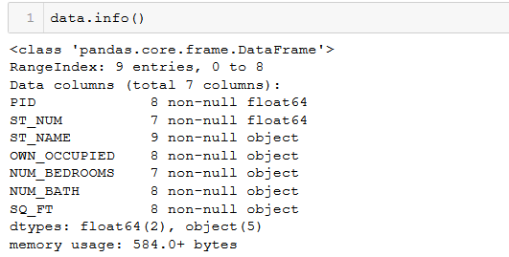
How many Missing Values are there?

Slide 16
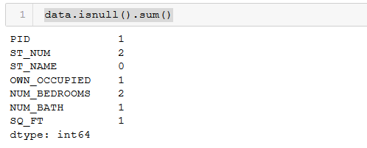
How many missing values are there ?

Slide 17
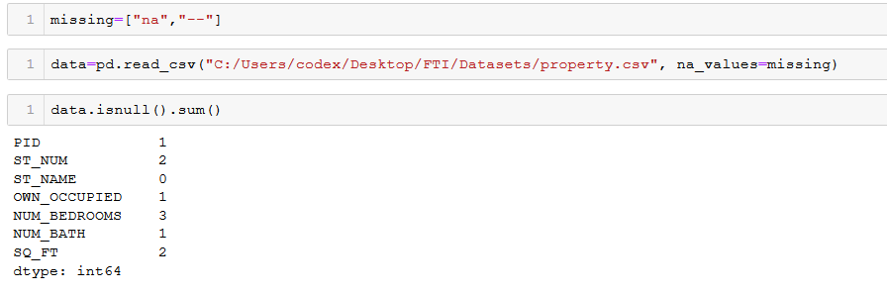
Defining the Missing Values

Slide 18
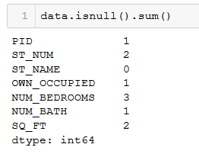

Slide 19
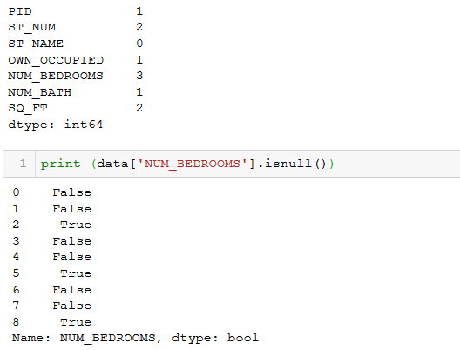
Checking Individual Columns for Null Values

Slide 20
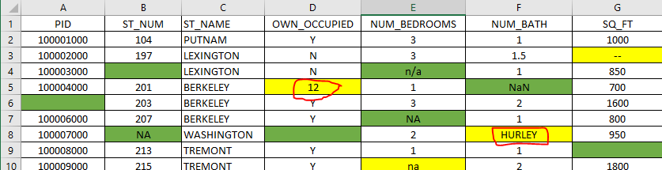
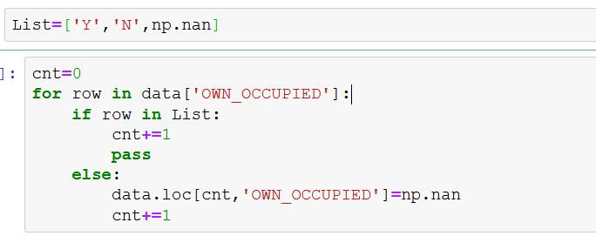
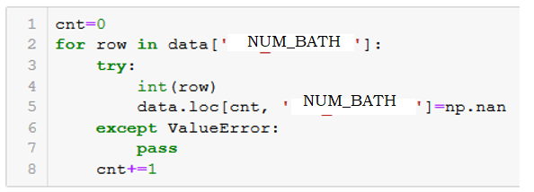
Converting invalid entries to NaN

Slide 21
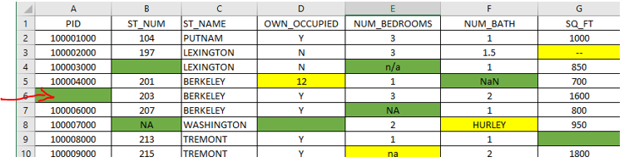

Dealing With Missing Values
Replace with a given Value

Slide 22
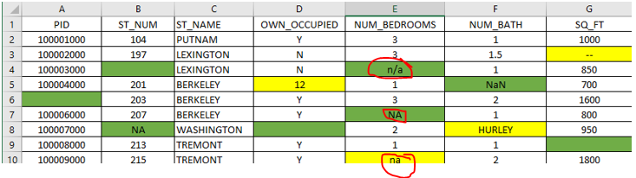
Replacing with Median – NUM_BEDROOMS

Slide 23
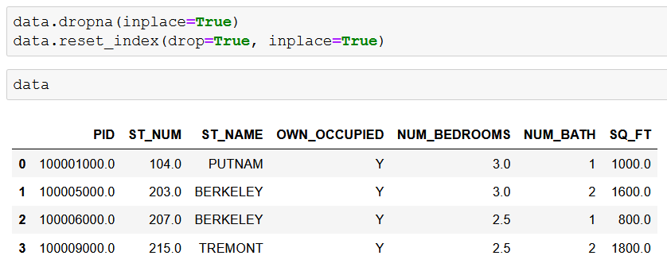
Deleting Rows with NULL Values
In some cases we can delete all the rows with Null Values

Slide 24
Lab2 : Handling Missing Values

